Slide 1
Lembaga Pengembangan dan Penjaminan Mutu Pendidikan
Universitas Sebelas Maret
14 Desember 2021
OUTCOME BASED EDUCATION ,
CASE METHOD DAN PROJECT BASED LEARNING
Bahrul Hayat
Universitas Islam Internasional Indonesia

Slide 2
OUTCOME-BASED EDUCATION

Slide 3
PARADIGM SHIFT OF EDUCATION
Objective-based
Competency-based
Outcome-based
Standard-based education
Institutional objective
Curricular objective
Instructional objective
Exit competency (SKL)
Course competency
Content standard
Process and Assessment standard
Program learning outcome
Course learning outcome

Slide 4
Outcome-Based Education
Outcome-based education is an education system where all subsystems of education are directed toward the achievement of the learning outcomes of an educational program and course.
The students take up courses with a certain goal of developing knowledge and skills and they have to complete the learning goals by end of the course.
Ideally the students are given freedom and flexibility to develop their learning strategy, pace, and style in line with their ability and conditions.
The faculty members guide the students based on the target of learning outcomes.

Slide 5

Outcome-Based Education
Not transferring knowledge
Student-centric learning approach.
Encompasses multi-facet learning domains (knowledge, technical skills, and non-cognitive skills)
Teaching the course beyond the classroom with authentic situation.
Students develop essential skills in solving problems
Students take responsibility and accountability for achieving their learning goals.

Slide 6
CASE METHOD

Slide 7
Why case method?
Critical and reflective thinking: Case method empowers students to think critically about the problematic situations (cases), reflect their proposed solutions, and act responsibly in their various roles.
Student engagement: Case teaching enhances learning by engaging students in very powerful ways and put students at the center of the learning process.
Constructing knowledge: In case teaching students actively connects the real cases with course contents and they simultaneously discover (or construct) a body of knowledge and master life learning skills.
Deeper learning: Case method promotes active learning with deeper understanding and improved retention.
Building interpersonal skills: Case method promotes collaborative learning and teamwork that is very critical to life success.
Building communication skills: Working on case studies increases student proficiency with written and oral communication

Slide 8

What is a case
Perplexed situation reflecting multi-layered real life problems that need students to come with reasonable solutions from multiple perspectives.
A case recounts objectively realistic and authentic events or problems so that students experience the complexities, ambiguities, and uncertainties.

Slide 9

Case format and requirements
Cases can take various formats. They can be formal written cases, a lead newspaper article, a movie clip, a news story, a picture, a mathematical word problem, a piece of art. Regardless of format, cases should:
  Illustrate issues and factors typical of the kind of problem under examination,
  Reflect theoretical frameworks,
  Underscore prevailing disciplinary assumptions and principles, and
  Reveal realistic complexities and tensions.

Slide 10
Characteristics of case method
Case teaching places the student at the center of the learning process. They are given significant responsibility for what and how they are learning.
The teacher helps students work collectively through the material to understand it. Students are asked not only to learn the theory but also to apply it to the complexity of the real world.
Students learn facts because they are central to case analysis but they also acquire requisite life-long learning skills of analysis, communication, and collaboration because they are necessary tools to unravel the puzzle.
A case class examines a real world problem and asks students to pull competing perspectives out of the case story itself.

Slide 11
Case teaching procedures
1. Setting learning goals
3. Prepare questions and prompts
4. Prepare your students
2. Choosing a case
5. Discussions
6. Assessment

Slide 12
Case-based Classroom Activities
Open and general discussion
Role play
Contrasting positions
Students develop case studies
Splitting aspects of a case

Slide 13
“A case teacher resembles an orchestra conductor. Much as a conductor creates music by coordinating individual performances, providing key signals, and knowing what the outcome should sound like, a case teacher generates learning by eliciting individual observations and analyses, asking key questions, and knowing what learning outcomes s/he wants students to achieve.”
(Vicki L. Golich et all, 2000)

Slide 14
Challenges of implementing case methos
Time
Finding right case
Learning assessment
Classroom management

Slide 15
PROJECT-BASED LEARNING

Slide 16
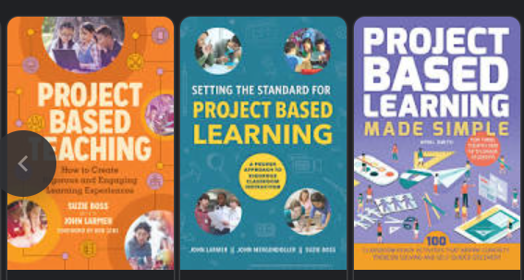
Why Project-Based Learning (PBL)?
Authentic experiences: With PBL students are confronted with problems they may face in real life situations.
Analytical thinking: In PBL, students are asked to break down problems into their component parts, process the problem, and implement a solution.
Creative and critical thinking: Students should use their critical thinking in dealing the problems and develop creative solutions to the problems.
Building interpersonal skills: Group PBL promotes collaborative learning and teamwork
Building communication skills: Working on a project enhance student communication skills.

Slide 17
Project-Based Learning (PBL)
Project-based learning(PBL) refers to an inquiry based instructional method that engages learners in knowledge construction by having them accomplish meaningful projects and develop real-world products (Brundiers & Wiek, 2013;Krajcik & Shin, 2014).
PBL is designed to give students the opportunity to develop knowledge and skills through engaging projects related to problems they may face in the real world.
The learning project take a period of time – from a week up to a semester – that engages students in solving a real-world problem or answering a complex question.
The students are asked to demonstrate their knowledge and skills by developing a project output (product or presentation).

Slide 18
Characteristics of Project-Based Learning (PBL)?
Focuses on question or problem for the student to research and respond to.
Students should implement their knowledge and skills in solving the problems.
Students use inquiry-based approach to generates sub-questions and seek answers
Develop key skills such as critical thinking, communication, collaboration, and creativity
Provides opportunities for feedback, constructive critism, and revision of the plan and the project.
Students are asked to present their problems, research process, methods, and results, just as scientific research or real-world projects.

Slide 19
PBL procedures
1. Setting learning goals
5. Progress monitoring
6. Final project assessment
2. Sharing timeline and progress report
3. Generate potential project ideas
4. Development and sharing assessment guides

Slide 20
Challenges of Project-Based Learning
Coach more and instruct less
Massive project vs manageable project
“Heat-burning relevance” problem
Progress variability

Slide 21
Benjamin Franklin
Tell me and I forgot.
Tech me an I remember.
Involve me and I learn.

Slide 22
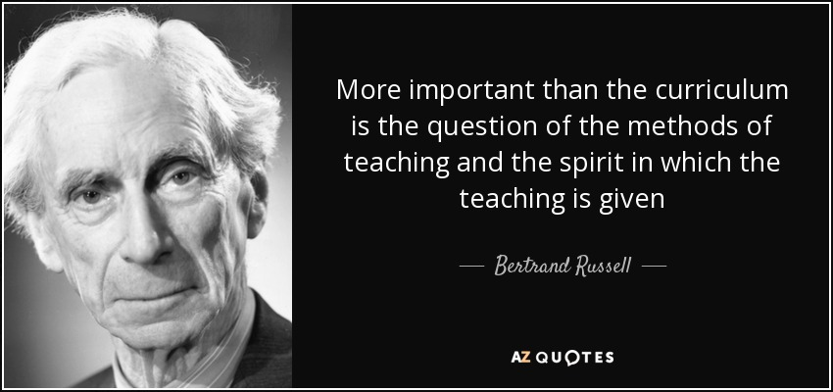

Slide 24
Terima kasih

